Slide 1
Intro to ASP.NET Core
Mike Rousos
Microsoft

Slide 2
Introductions
How many of you are new to .NET?
How many of you are new to ASP.NET?
How many of you are familiar with ASP.NET MVC?
How many of you were there when .NET 1.0 was released?
How many of you primarily write in C#? VB? F#? Java? JavaScript? Python? Ruby? Erlang? Something else?

Slide 3
Workshop resources
Labs:
https://github.com/mjrousos/aspnetcore-workshop
Bits:
https://github.com/mjrousos/aspnetcore-workshop/blob/master/README.md

Slide 4
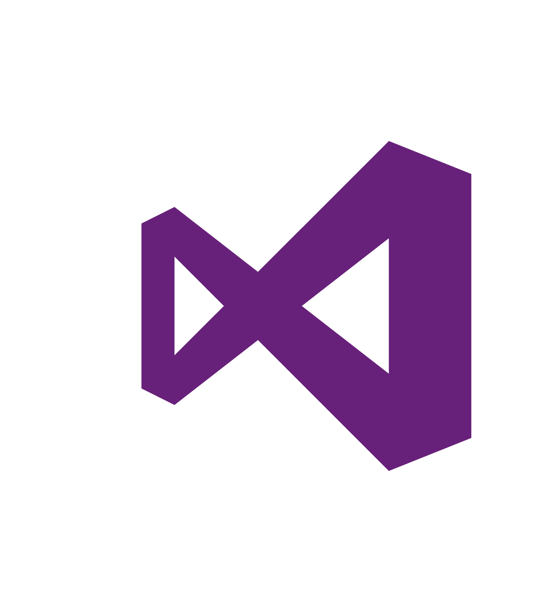
.NET platform
DESKTOP
.NET FRAMEWORK
WINDOWS UWP
.NET CORE
ASP.NET
MOBILE
CLOUD
XAMARIN
TOOLS
Visual Studio
.NET STANDARD LIBRARY
Visual Studio for Mac
COMMON INFRASTRUCTURE
Visual Studio Code
Compilers
Languages
Runtime components

Slide 5
.NET Core -- Cross-platform services
DESKTOP
.NET FRAMEWORK
WINDOWS UWP
.NET CORE
ASP.NET
MOBILE
CLOUD
XAMARIN
TOOLS
Visual Studio
.NET STANDARD LIBRARY
Visual Studio for Mac
COMMON INFRASTRUCTURE
Visual Studio Code
Compilers
Languages
Runtime components

Slide 6

.NET Core
Cross-platform
Windows, Linux and macOS

Slide 7

http://redhatloves.net

Slide 8
Supported OSes
Windows
Windows 7+
Server 2008 R2 SP1+
Server 2016 (incl. Nano)
macOS
Sierra
Linux
RHEL
Fedora
Centos
Debian
Ubuntu
Linux Mint
openSUSE
Oracle Linux

Slide 9

.NET Core
Cross-platform
Windows, Linux and macOS
Fast
ASP.NET Core on .NET Core is 4x faster than Node.js in TechEmpower benchmark

Slide 10
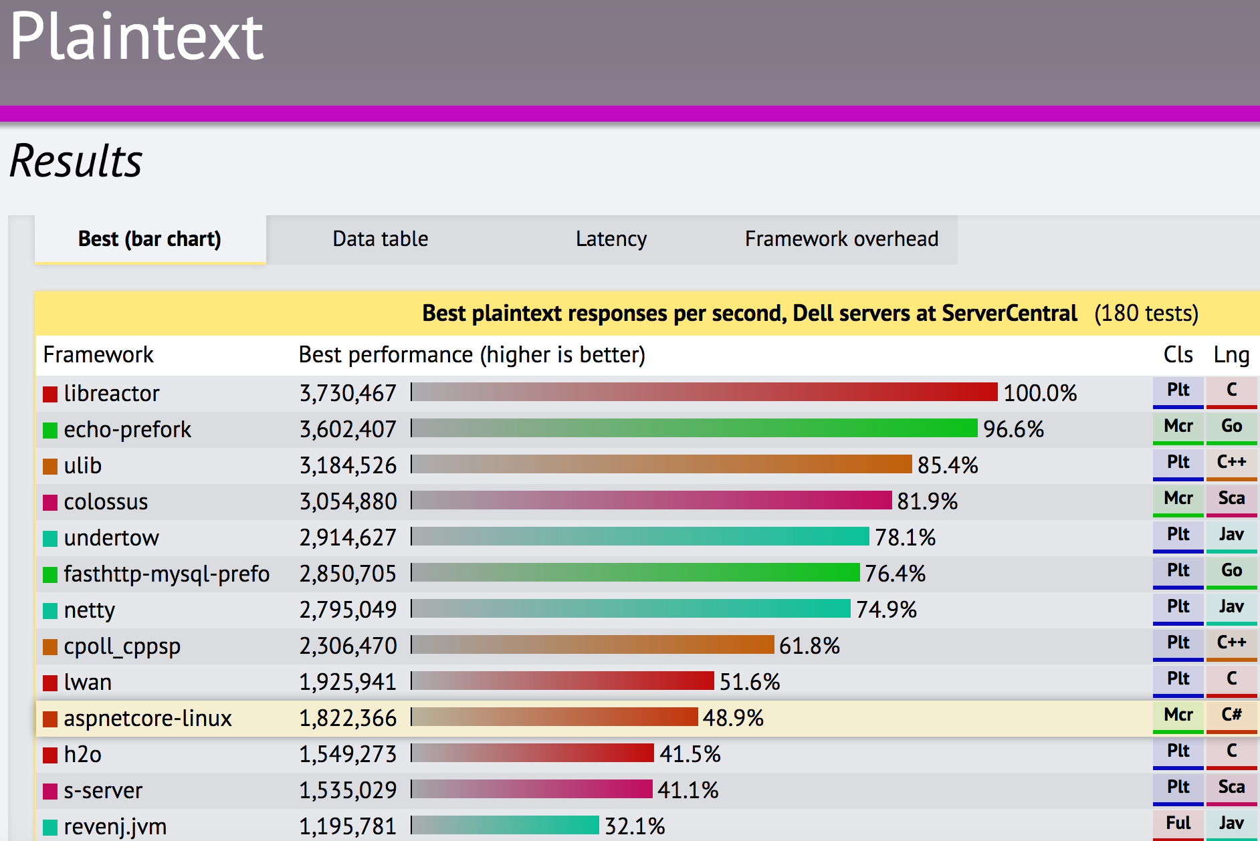
TechEmpower Framework Benchmarks – Round 13 – PlainText
https://techempower.com/benchmarks/

Slide 11

.NET Core
Cross-platform
Windows, Linux and macOS
Fast
ASP.NET Core on .NET Core is 4x faster than Node.js in TechEmpower benchmark
Lightweight
No impact deployment and a modular development model perfect for containers

Slide 12
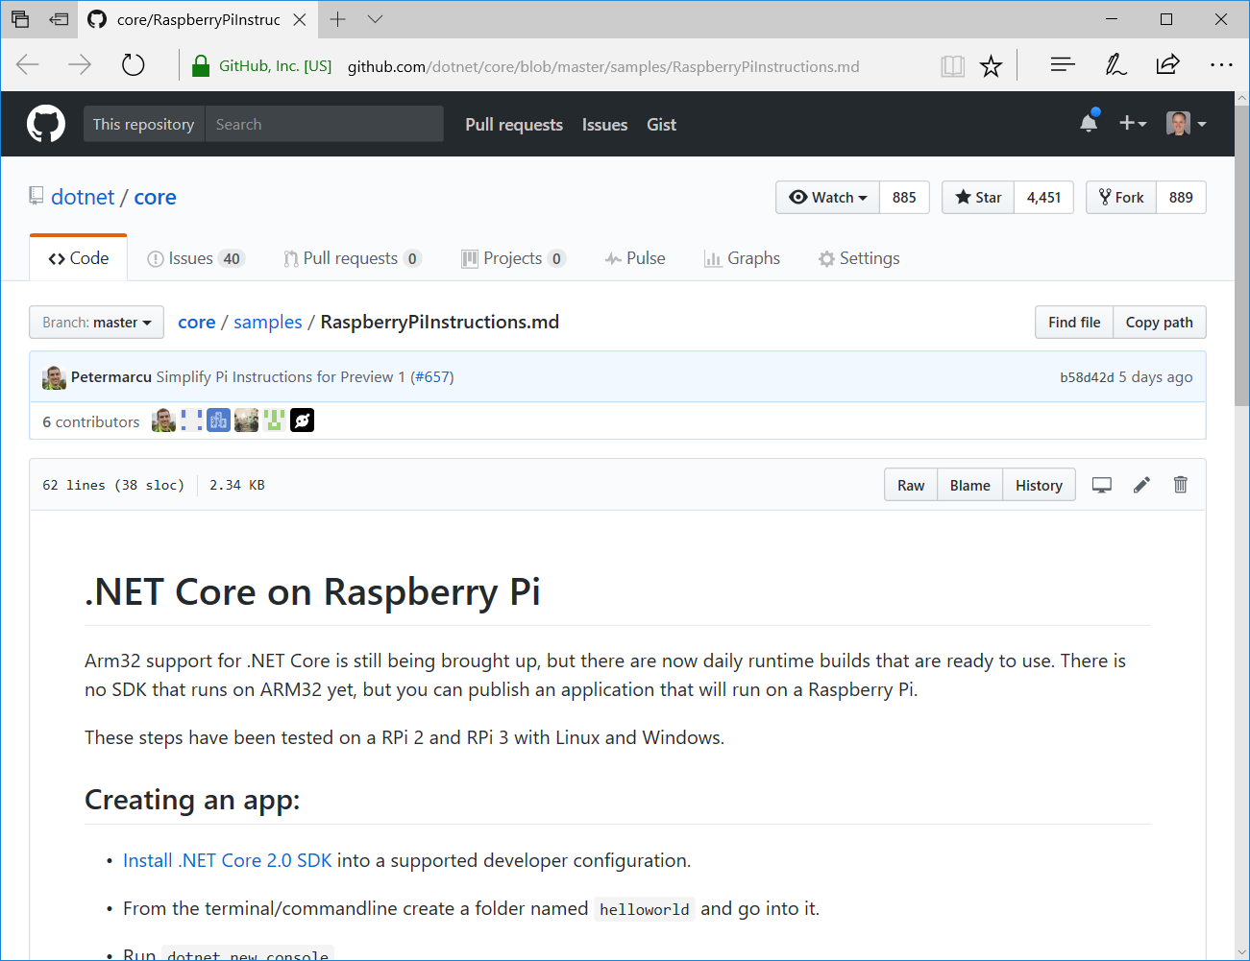
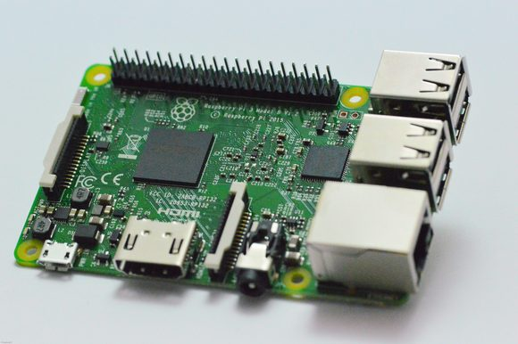

Slide 13
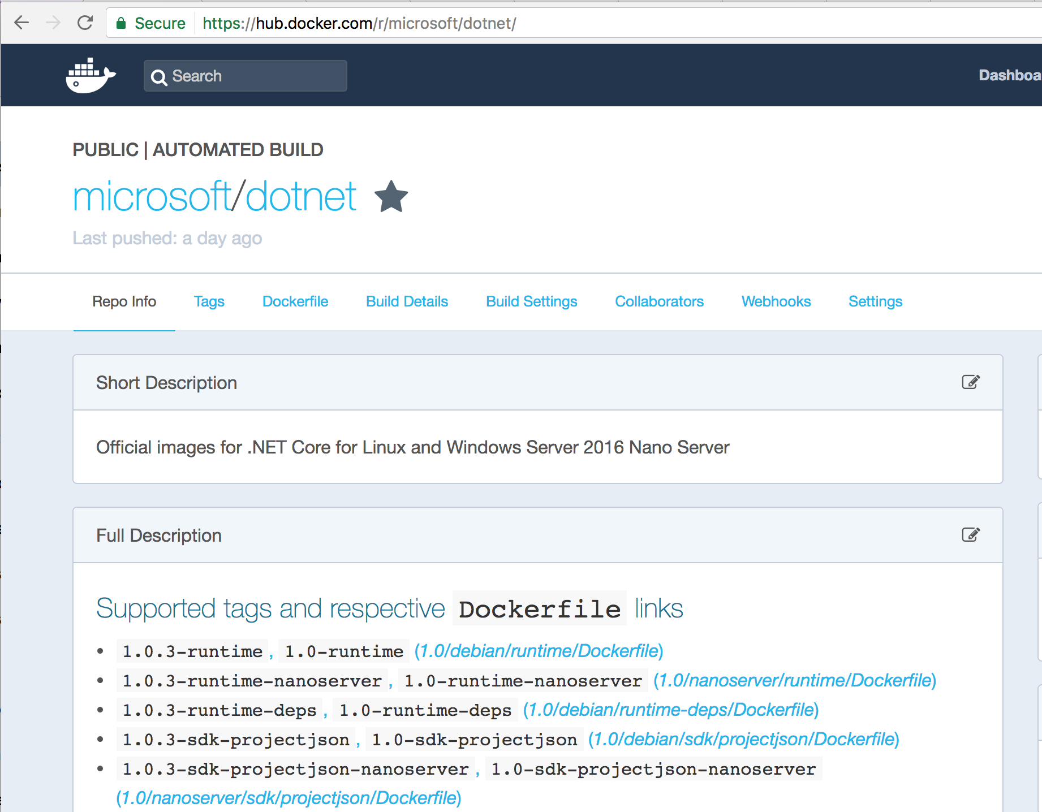

Slide 14

.NET Core
Cross-platform
Windows, Linux and macOS
Fast
ASP.NET Core on .NET Core is 4x faster than Node.js in TechEmpower benchmark
Lightweight
No impact deployment and a modular development model perfect for containers
Open source
Runtime, libraries, compiler, languages and tools developed in the open in GitHub

Slide 15

.NET Open Source Contributions as of 2016

Slide 16

Get .NET Core
Install the .NET Core SDK (https://dot.net)
Install Visual Studio (https://visualstudio.com)
Visual Studio
Windows
Visual Studio for Mac
macOS
Visual Studio Code
Windows, macOS, Linux

Slide 17
Getting Started with .NET Core
Notes:
dotnet new console
dotnet run
dotnet .dll
dotnet build

Slide 18
.NET Core Command Line Interface (CLI)
> dotnet new console // creates new project
> dotnet restore // restore NuGet dependencies
> dotnet build // builds your source into dlls
> dotnet path-to/yourapp.dll //loads and runs
> dotnet run // same thing as the last 2 lines
> dotnet add // add package or project references
> dotnet test // runs your tests;reports pass/fail
> dotnet publish // prepares app for distribution
> dotnet pack // packages library as NuGet package

Slide 19
ASP.NET Core
Fast & lightweight web framework built for .NET Core
Build modern web apps
MVC apps, Web APIs, SPAs, mobile apps, microservices, docker, real-time (future)
Integrates seamless with Azure cloud services
Azure App Services, SQL Azure, Azure Key Vault, Azure Application Insights, Azure Active Directory, etc.
Or run it on premise, on Google App Engine, on AWS, etc.
Powerful security features
HTTPS, identity, data protection, OpenID Connect, JWT, CORS, 2-factor auth, social logins
Simple composable infrastructure
Dependency injection, middleware, configuration, logging, localization, routing, session, error handling

